Slide 1
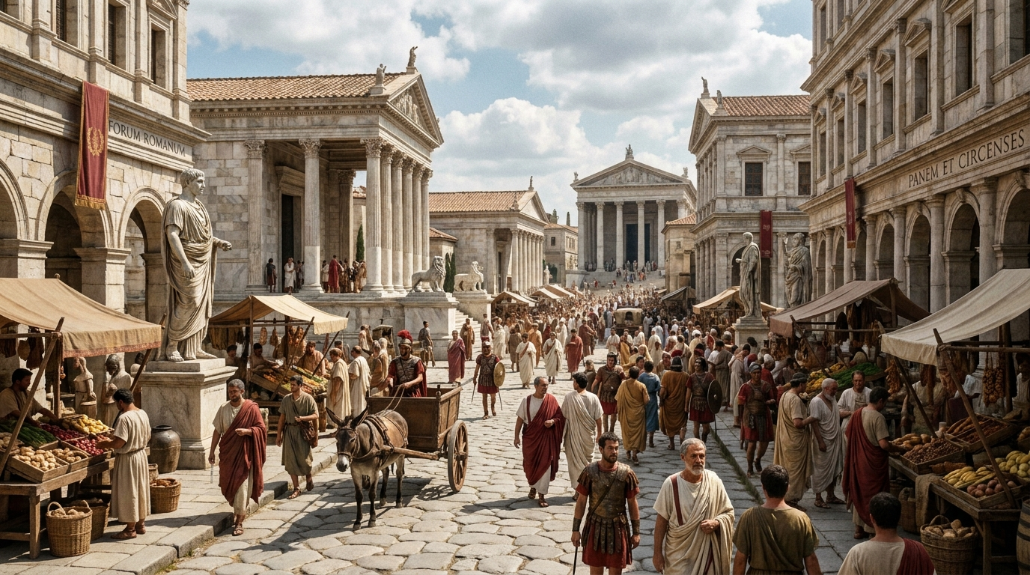
Romans

Slide 2


Slide 3


Slide 4
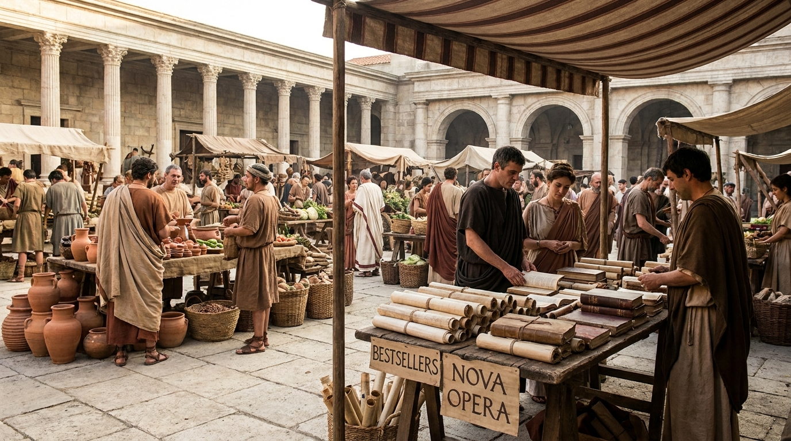

Slide 5
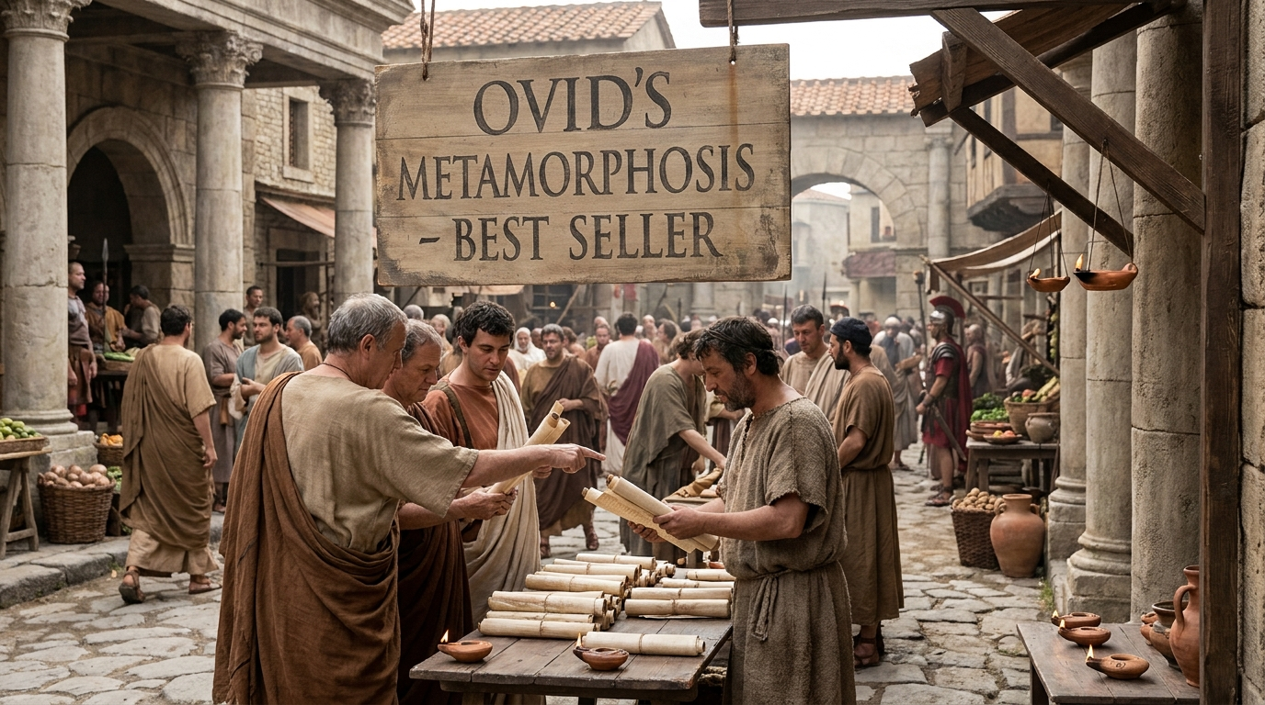

Slide 6
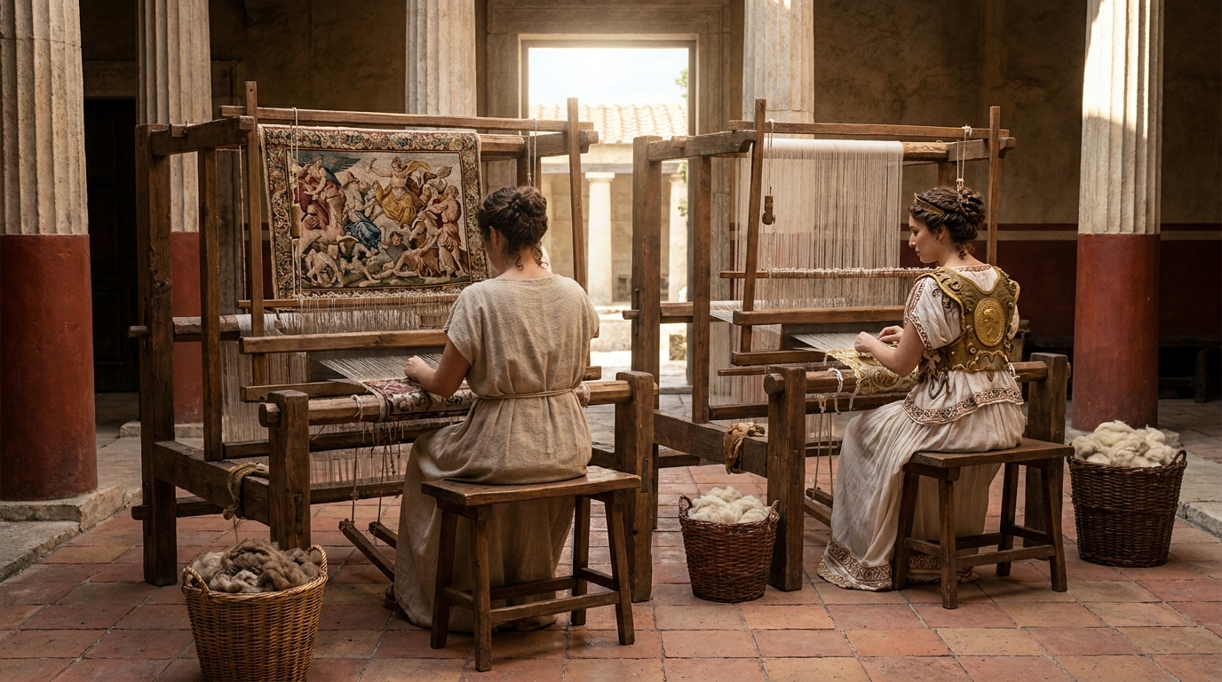
Arachne vs. Minerva

Slide 7
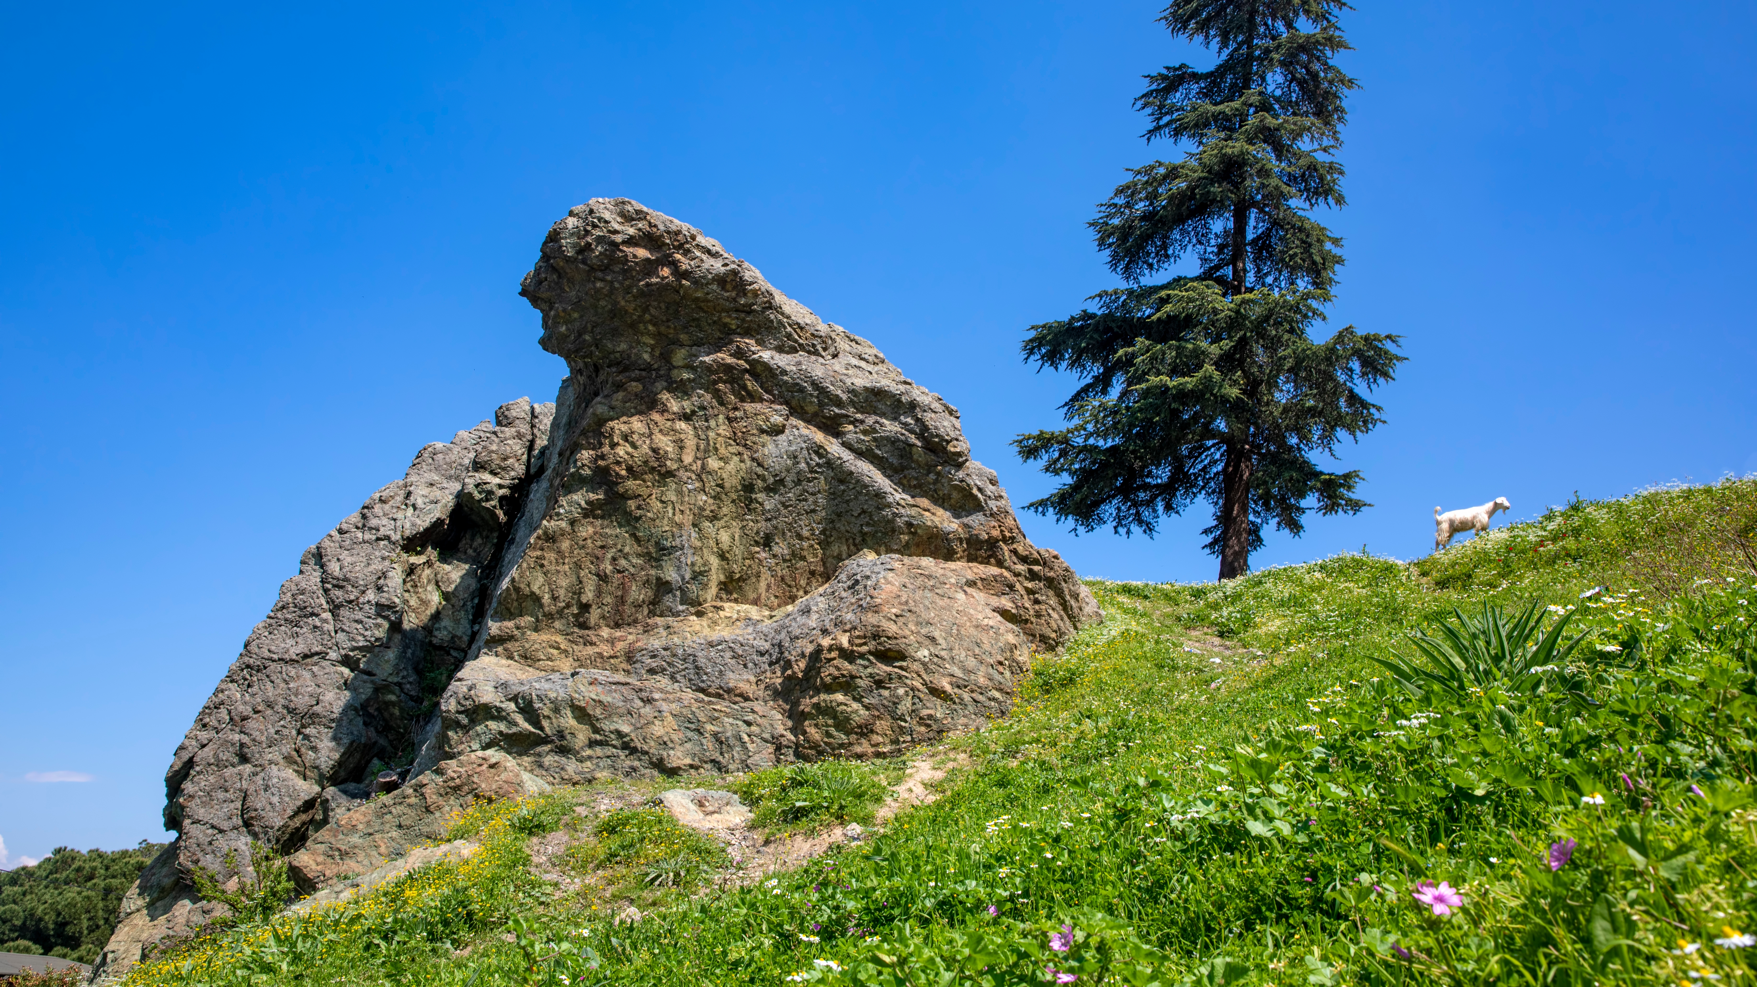
Niobe and Latona
Notes:
Apollo and Artemis shoot all 14.

Slide 8
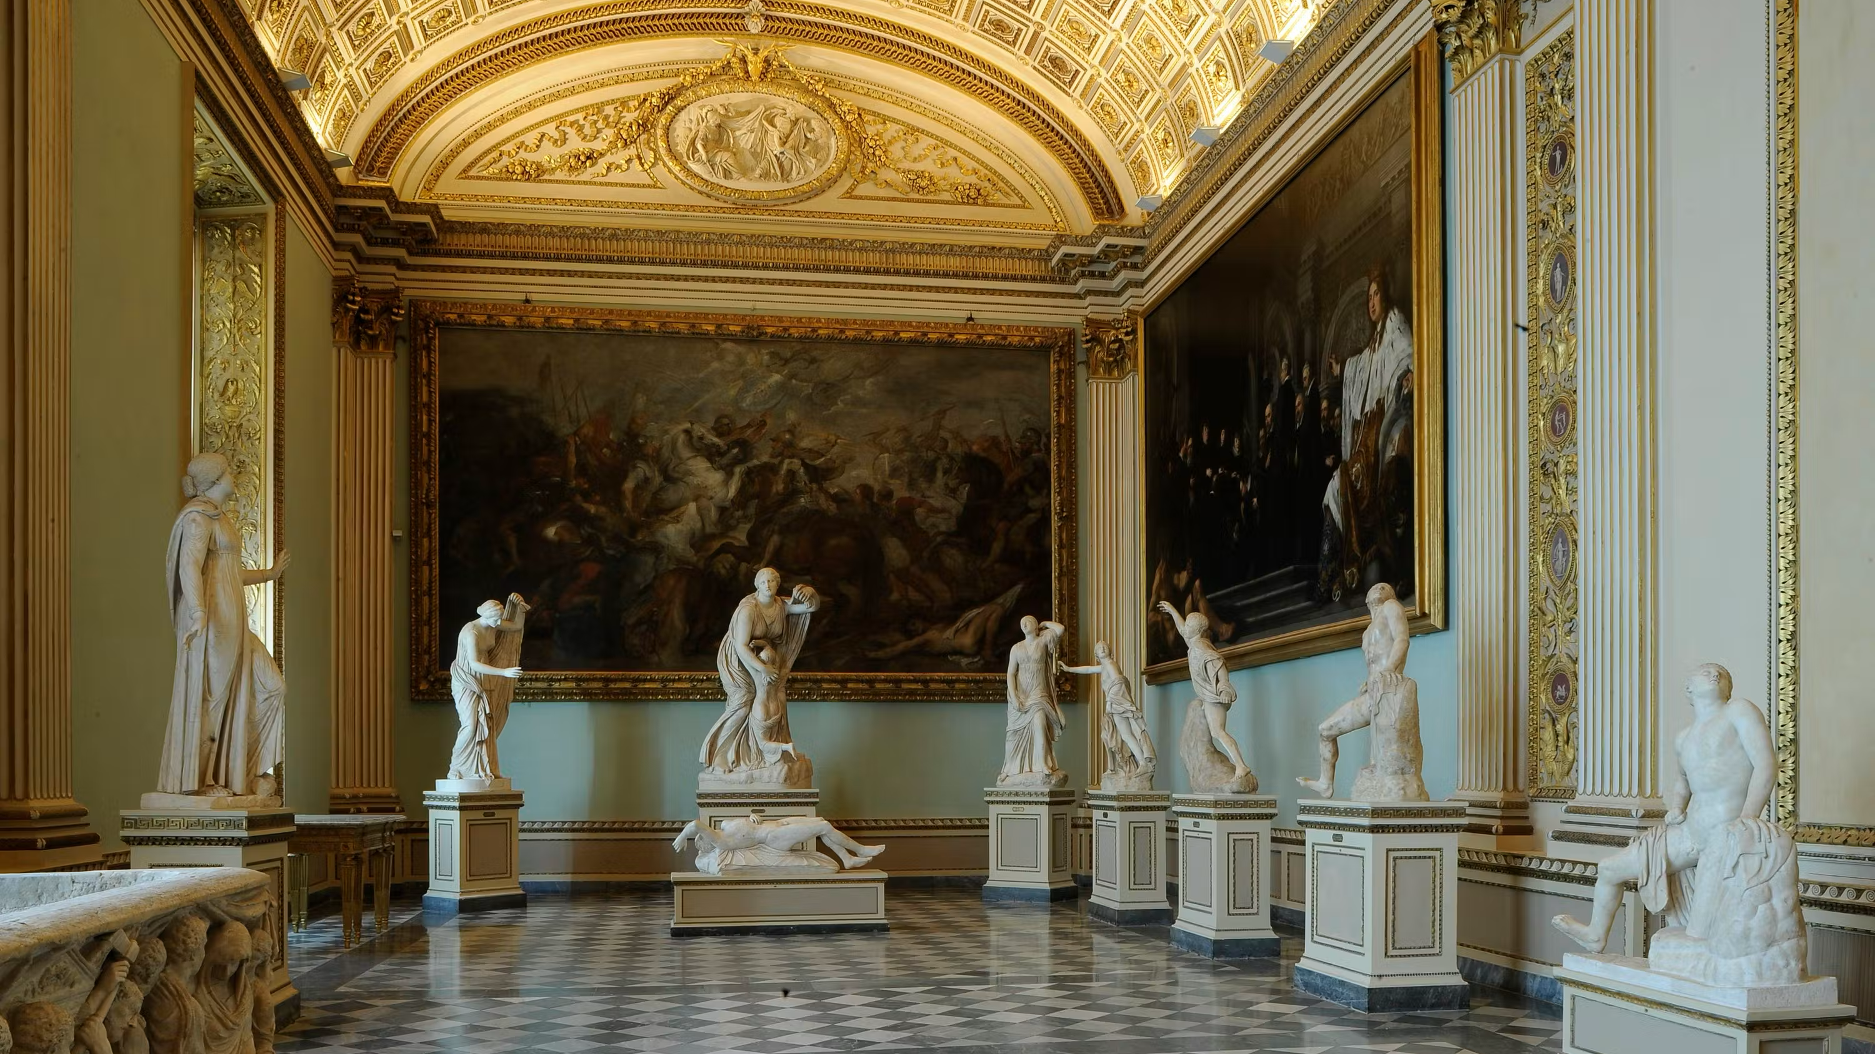
Notes:
Florence Italy Uffizi Niobe room found in Rome 1583

Slide 9
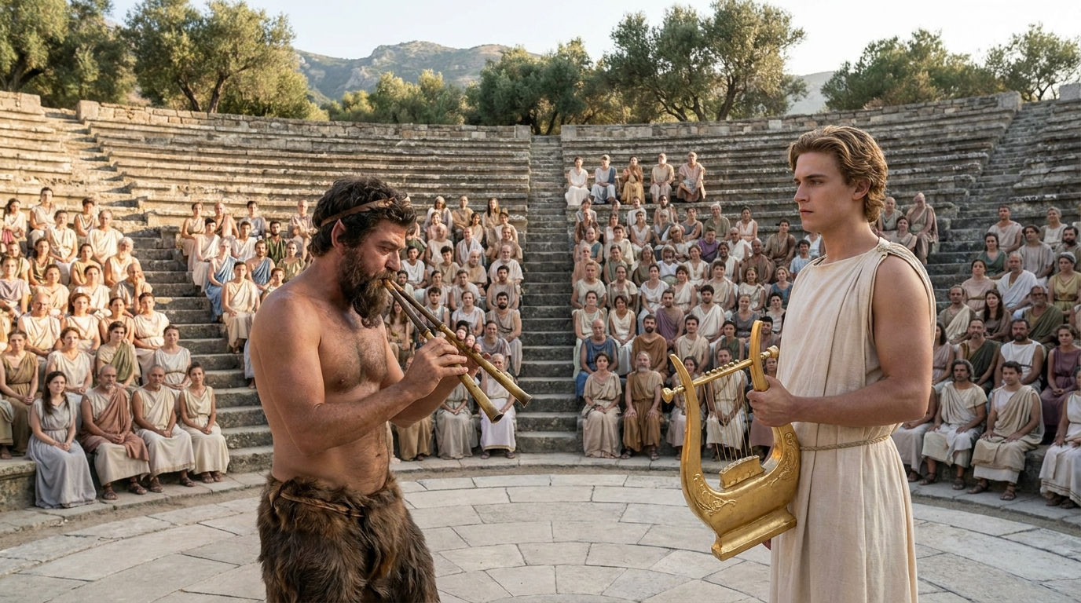
Marsyas vs. Apollo

Slide 10
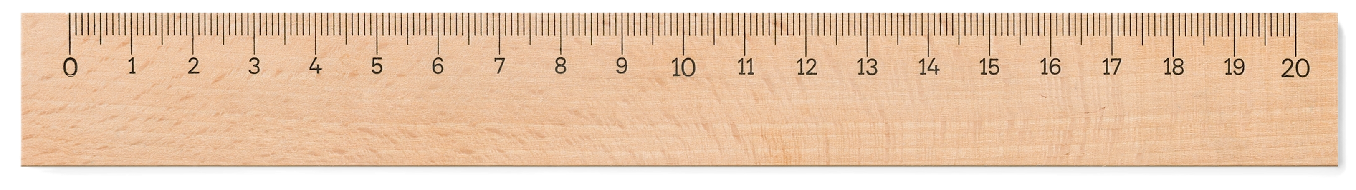
The Rule:
A mortal who answers back to a god gets obliterated, and the god doesn't owe him an explanation

Slide 11
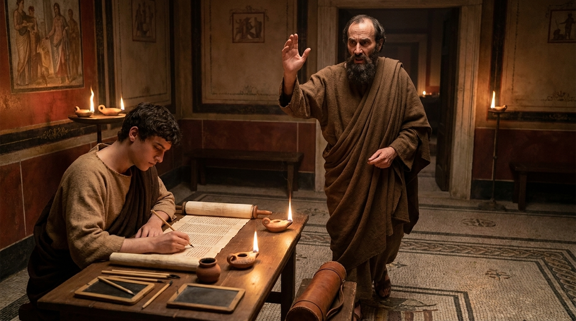
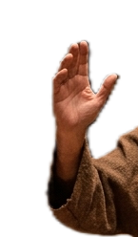

“But who are you, O man, to answer back to God?

Slide 12
Rom. 9:20
Rom. 9:20
But who are you, O man, to answer back to God?
ὦ ἄνθρωπε, μενοῦνγε σὺ τίς εἶ ὁ ἀνταποκρινόμενος τῷ θεῷ;

Slide 13
Rom. 9:20
Rom. 9:20
But who are you, O man, to answer back to God?
ὦ ἄνθρωπε, μενοῦνγε σὺ τίς εἶ ὁ ἀνταποκρινόμενος τῷ θεῷ;

Slide 14
Rom. 9:20
Rom. 9:20
But who are you, O man, to answer back to God?
ὦ ἄνθρωπε, μενοῦνγε σὺ τίς εἶ ὁ ἀνταποκρινόμενος τῷ θεῷ;
ἀνταποκρινόμενος
is dispute talk

Slide 15
Rom. 9:20
Rom. 9:20
But who are you, O man, to answer back to God?
ὦ ἄνθρωπε, μενοῦνγε σὺ τίς εἶ ὁ ἀνταποκρινόμενος τῷ θεῷ;
ἀνταποκρινόμενος
is dispute talk
ἀνταποκρινόμενος
“to reply against”

Slide 16
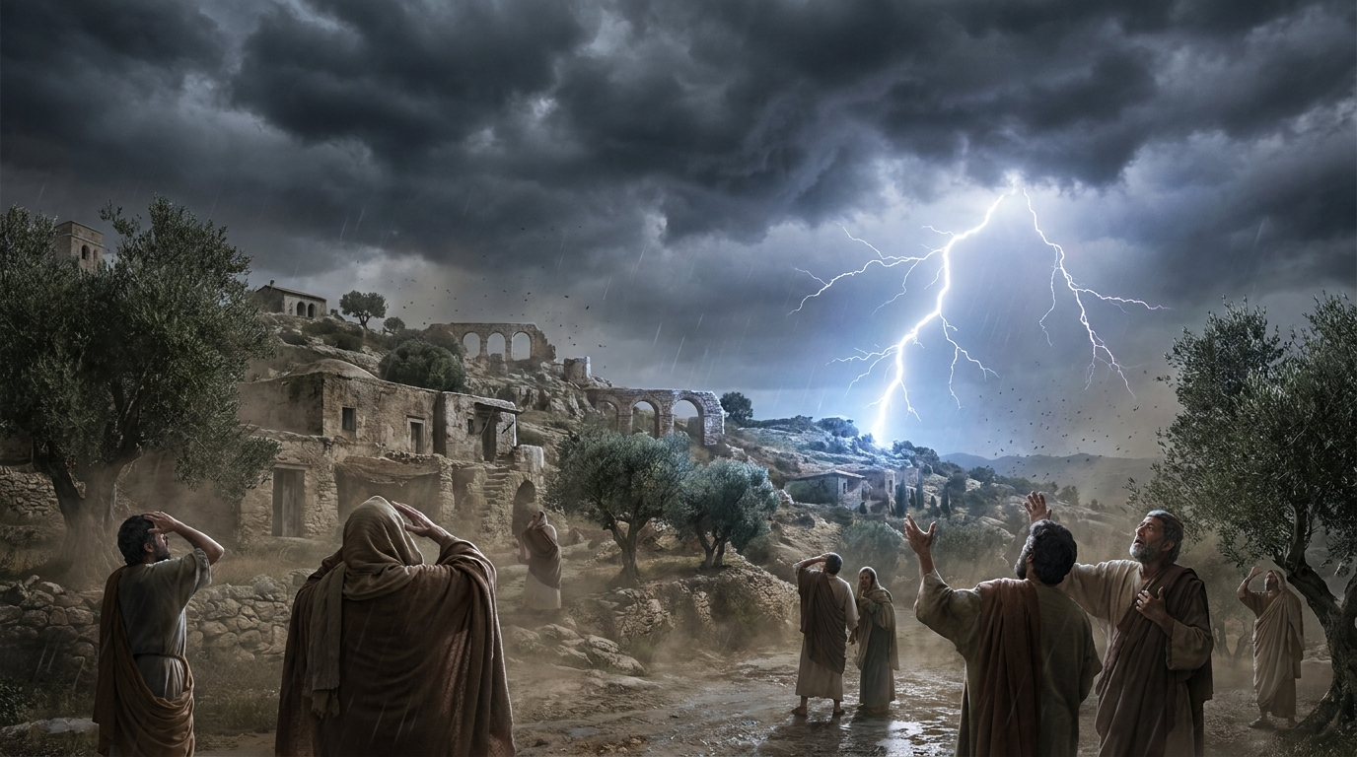
The expectant thunderbolt?

Slide 17
Rom. 9:20
Rom. 9:20
But who are you, O man, to answer back to God?
ὦ ἄνθρωπε, μενοῦνγε σὺ τίς εἶ ὁ ἀνταποκρινόμενος τῷ θεῷ;

Slide 18
Rom. 9:20
Rom. 9:20
But who are you, O man, to answer back to God? Will what is molded say to its molder, “Why have you made me like this?”
ὦ ἄνθρωπε, μενοῦνγε σὺ τίς εἶ ὁ ἀνταποκρινόμενος τῷ θεῷ; μὴ ἐρεῖ τὸ πλάσμα τῷ πλάσαντι· τί με ἐποίησας οὕτως;

Slide 19
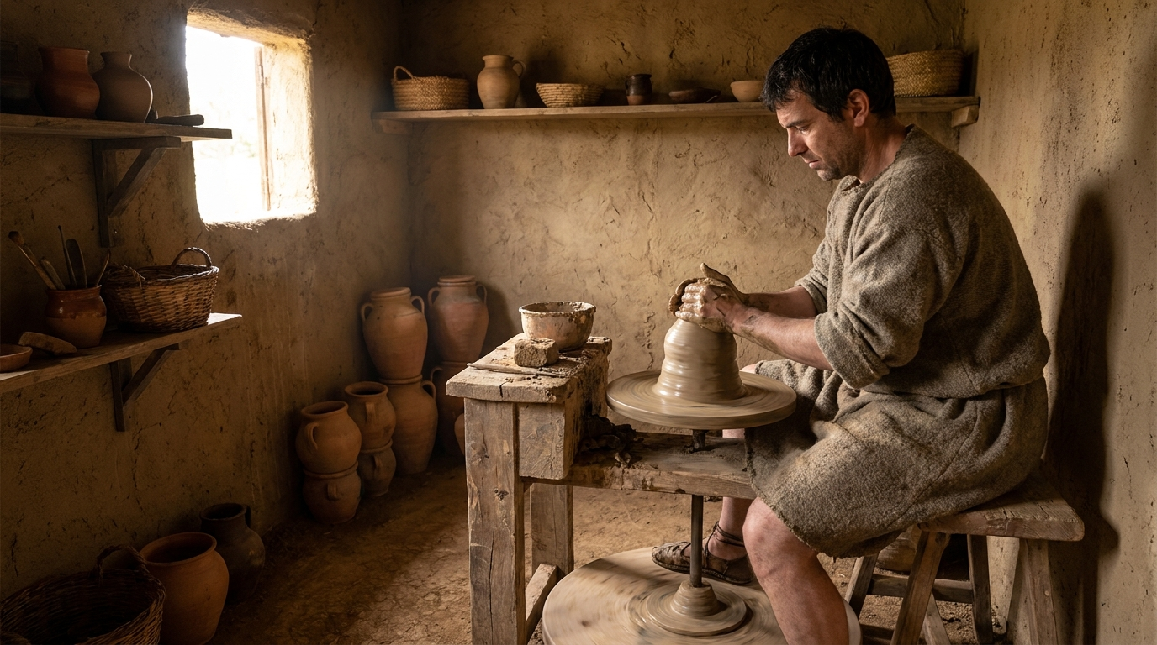
The potter in the studio

Slide 20
The potter in the studio
Jeremiah’s potter remakes the vessel

Slide 21
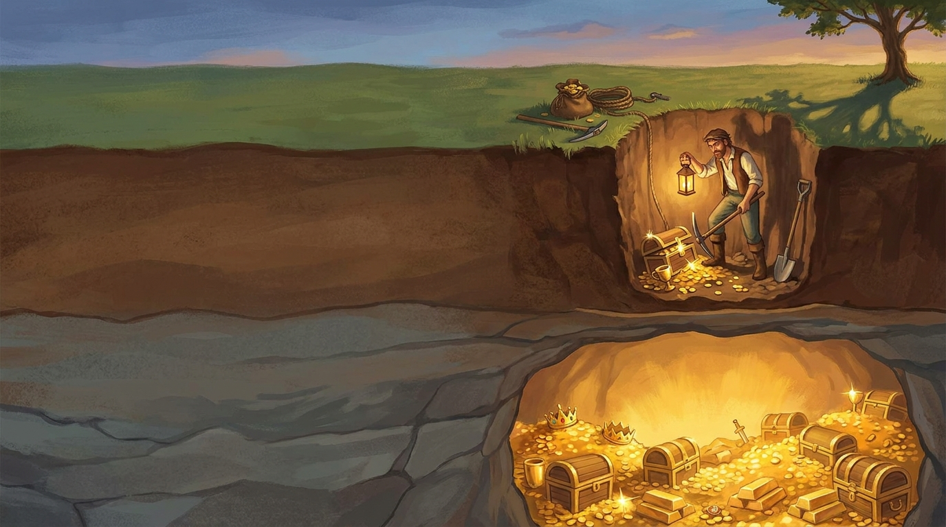
Let’s pick up from last class’s verses and go deeper.

Slide 22
Let’s pick up from last class’s verses and go deeper.

Slide 23
Did God’s word fail?

Slide 24
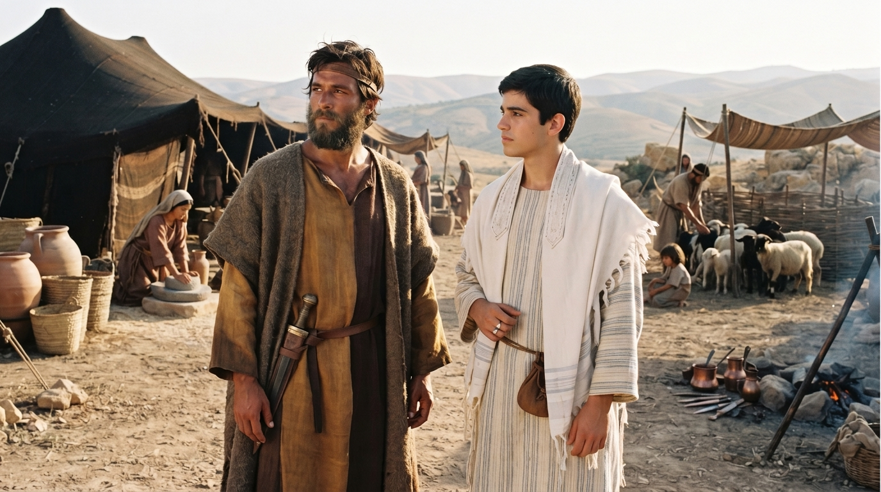

Slide 25
“Not all who are descended from Israel belong to Israel” (Rom. 9:6)

Slide 26
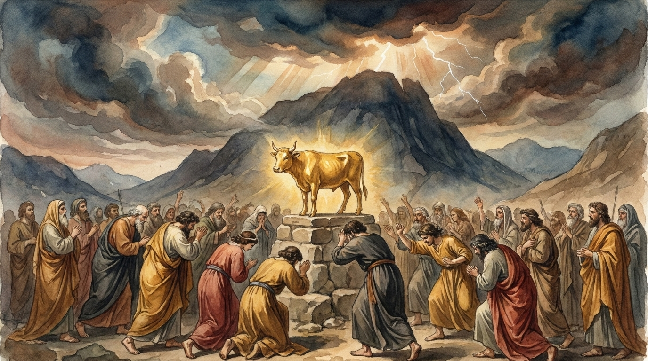
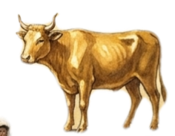
Mercy is never owed

Slide 27
Mercy is never owed
“I will have mercy on whom I have mercy, and I will have compassion on whom I have compassion.”
(Rom. 9:15)

Slide 28
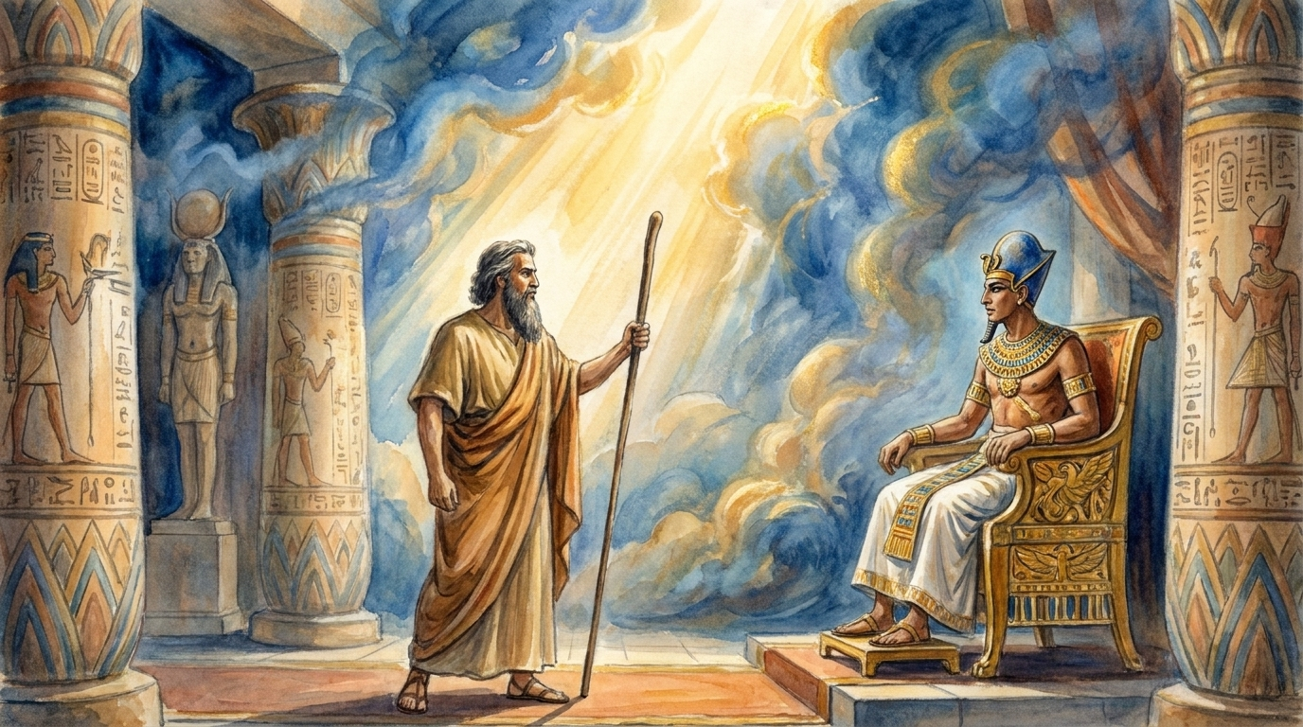
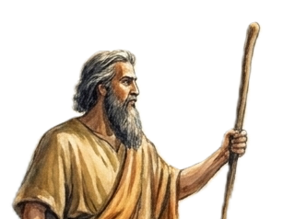

Slide 29
For the Scripture says to Pharaoh, “For this very purpose I have raised you up, that I might show my power in you, and that my name might be proclaimed in all the earth.” (Rom. 9:17)

Slide 30


TWO POSSIBLE ANSWERS
ONE QUESTION
“
Historical Role?
Election to what?
Salvation

Slide 31
TWO POSSIBLE ANSWERS
ONE QUESTION
“
Historical Role?
Called?
Salvation

Slide 32
TWO POSSIBLE ANSWERS
ONE QUESTION
“
Historical Role?
Saved?
Salvation

Slide 33
TWO POSSIBLE ANSWERS
ONE QUESTION
“
Saved?
Salvation

Slide 34
TWO POSSIBLE ANSWERS
ONE QUESTION
“
Individual?
Saved?
Salvation

Slide 35
TWO POSSIBLE ANSWERS
ONE QUESTION
“
Individual?
Saved?
Salvation
The faithful

Slide 37
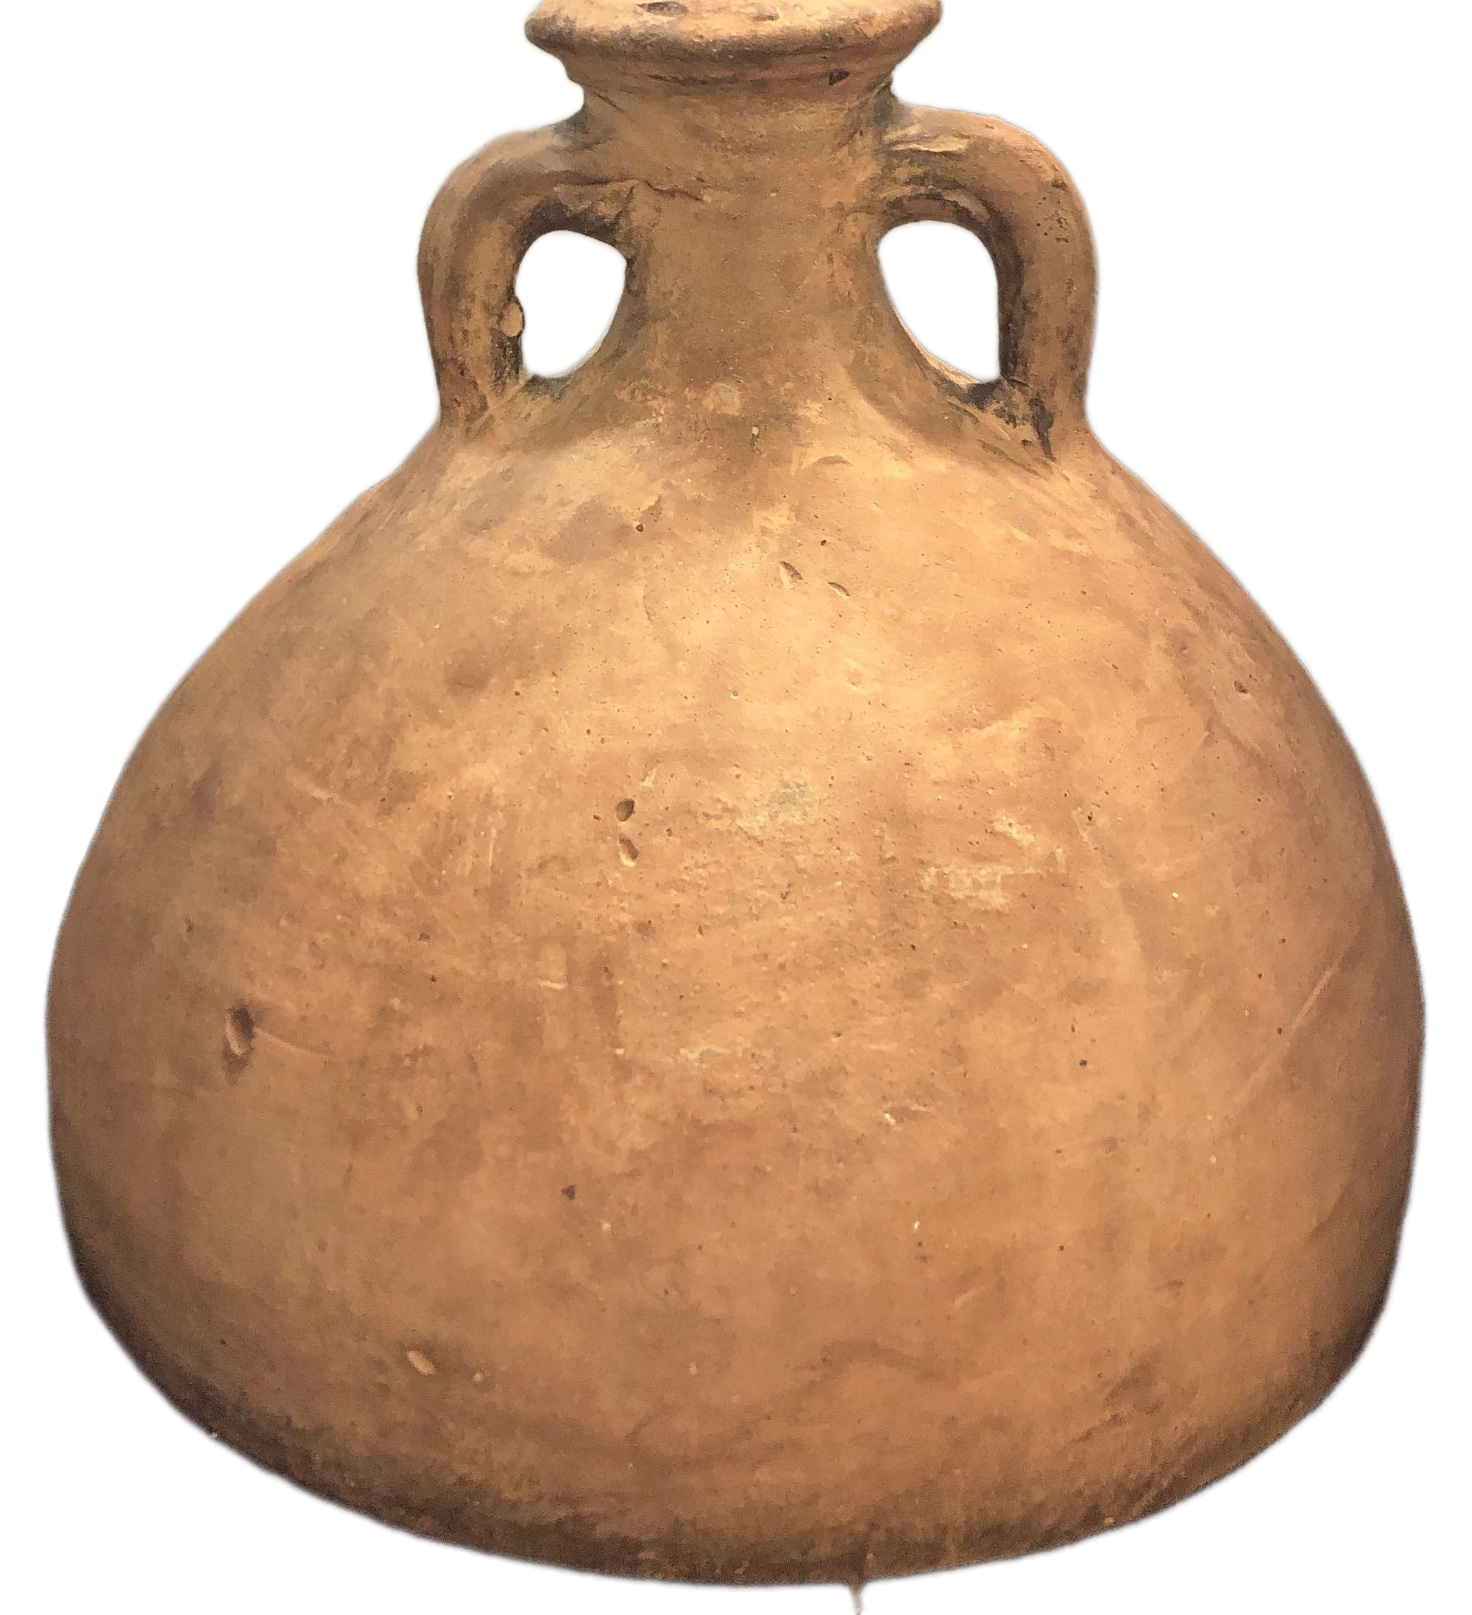
The Objector Echoes Job (vv. 19-20a)

Slide 38
The Objector Echoes Job (vv. 19-20a)
The Potter’s Rights (vv. 20b-21)

Slide 39
The Objector Echoes Job (vv. 19-20a)
The Potter’s Rights (vv. 20b-21)
Two vessels and an Open Door (vv. 22-24)

Slide 40
The Objector Echoes Job (vv. 19-20a)

Slide 41
Rom. 9:18
Rom. 9:18
So then he has mercy on whomever he wills, and he hardens whomever he wills.
ἄρα οὖν ὃν θέλει ἐλεεῖ, ὃν δὲ θέλει σκληρύνει.

Slide 42
Rom. 9:19
Rom. 9:19
You will say to me then, “Why does he still find fault? For who can resist his will?”
Ἐρεῖς μοι οὖν· τί [οὖν] ἔτι μέμφεται; τῷ γὰρ βουλήματι αὐτοῦ τίς ἀνθέστηκεν;
Notes:
μέμφεται present middle
ἀ̓νθέστηκεν set oneself against

Slide 43
Rom. 9:20
Rom. 9:20
But who are you, O man, to answer back to God?
ὦ ἄνθρωπε, μενοῦνγε σὺ τίς εἶ ὁ ἀνταποκρινόμενος τῷ θεῷ;

Slide 44
Rom. 9:20
Rom. 9:20
But who are you, O man, to answer back to God?
ὦ ἄνθρωπε, μενοῦνγε σὺ τίς εἶ ὁ ἀνταποκρινόμενος τῷ θεῷ;

Slide 45
Rom. 9:20
Rom. 9:20
But who are you, O man, to answer back to God?
ὦ ἄνθρωπε, μενοῦνγε σὺ τίς εἶ ὁ ἀνταποκρινόμενος τῷ θεῷ;
ἀνταποκρινόμενος
is dispute talk

Slide 46
Rom. 9:20
Rom. 9:20
But who are you, O man, to answer back to God?
ὦ ἄνθρωπε, μενοῦνγε σὺ τίς εἶ ὁ ἀνταποκρινόμενος τῷ θεῷ;
ἀνταποκρινόμενος
is dispute talk
ἀνταποκρινόμενος
“to reply against”

Slide 47


Slide 48
We tend to approach this in a different way from Paul, for we tend to think of the eternal destiny of the individual. We must bear in mind throughout this section that Paul is not dealing with that subject.

Slide 50
He is dealing with the failure of Israel as a whole to respond to the Messiah over against the fact that the church was largely Gentile. He is saying that God works his purpose out by such means as choosing Isaac and rejecting Ishmael, choosing Jacob and rejecting Esau, or hardening Pharaoh.

Slide 52
He is arguing that Israel’s present hardening does not defeat God’s purpose, but rather that it is God’s means of bringing the gospel to the Gentiles. This may have an application to individuals, but Paul does not spell it out.

Slide 53
Rom. 9:20
Rom. 9:20
But who are you, O man, to answer back to God?
ὦ ἄνθρωπε, μενοῦνγε σὺ τίς εἶ ὁ ἀνταποκρινόμενος τῷ θεῷ;

Slide 54
Rom. 9:20
Rom. 9:20
But who are you, O man, to answer back to God?
ὦ ἄνθρωπε, μενοῦνγε σὺ τίς εἶ ὁ ἀνταποκρινόμενος τῷ θεῷ;

Slide 55
Rom. 9:20
Rom. 9:20
But who are you, O man, to answer back to God?
ὦ ἄνθρωπε, μενοῦνγε σὺ τίς εἶ ὁ ἀνταποκρινόμενος τῷ θεῷ;
ἀνταποκρινόμενος
is dispute talk

Slide 56
Rom. 9:20
Rom. 9:20
But who are you, O man, to answer back to God?
ὦ ἄνθρωπε, μενοῦνγε σὺ τίς εἶ ὁ ἀνταποκρινόμενος τῷ θεῷ;
ἀνταποκρινόμενος
is dispute talk
ἀνταποκρινόμενος
“to reply against”

Slide 57


Slide 58
Job

Slide 59
“Who will say to God, ‘What are you doing?’” (9:12)
Job

Slide 60
Wisdom of Solomon
“Who will say to God, ‘What are you doing?’” (9:12)
Job

Slide 61
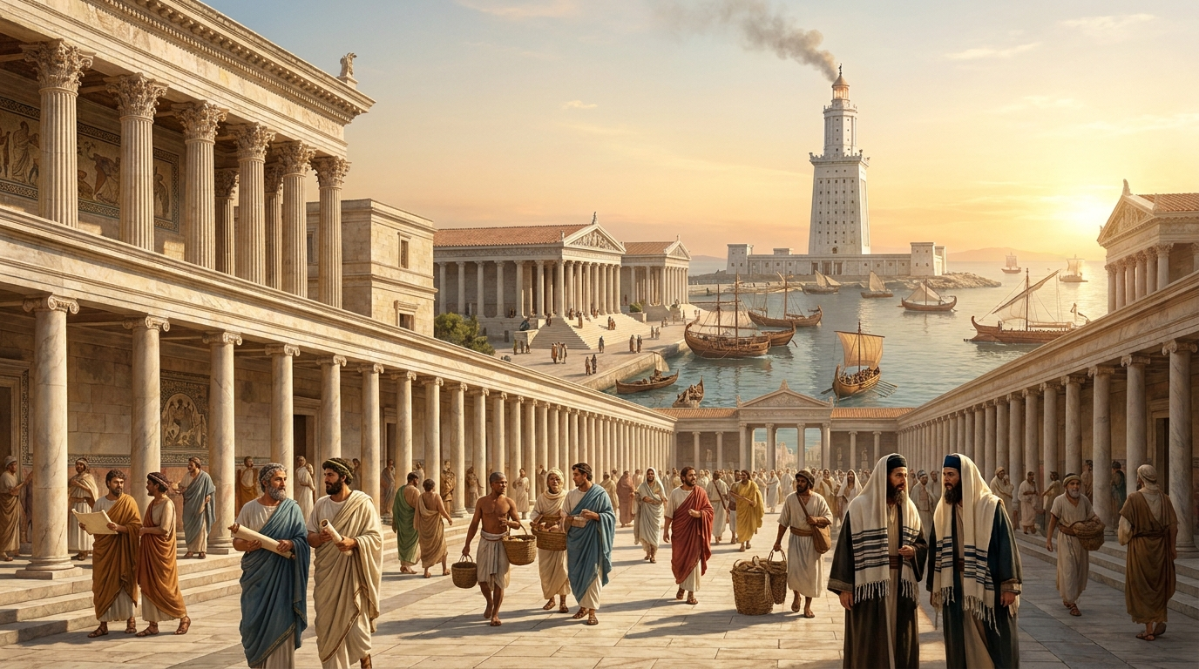
Alexandria
~ BC100

Slide 62
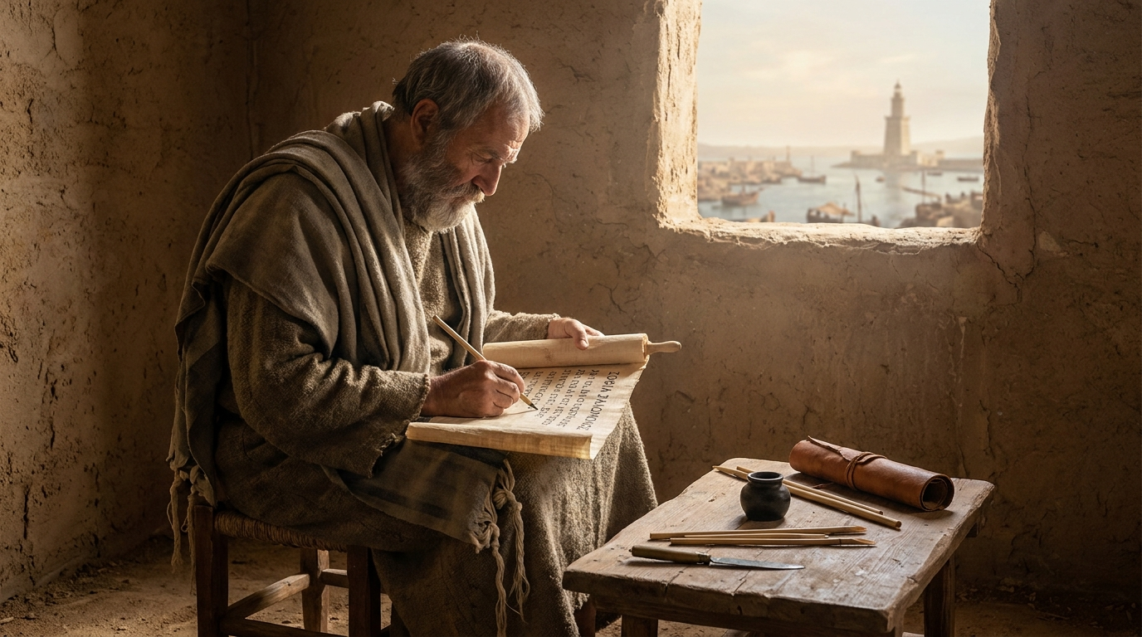
The Wisdom of Solomon

Slide 63
Wisdom of Solomon
“Who will say to God, ‘What are you doing?’” (9:12)
Job

Slide 64
Wisdom of Solomon
“who will say, ‘What have you done?’ Or will resist your judgment?’” (12:12)
“Who will say to God, ‘What are you doing?’” (9:12)
Job

Slide 65
Paul
Wisdom of Solomon
“who will say, ‘What have you done?’ Or will resist your judgment?’” (12:12)
“Who will say to God, ‘What are you doing?’” (9:12)
Job

Slide 66
“who can resist your will?” “Why have you made me like this?’” (9:19, 20)
Paul
Wisdom of Solomon
“who will say, ‘What have you done?’ Or will resist your judgment?’” (12:12)
“Who will say to God, ‘What are you doing?’” (9:12)
Job

Slide 67
The Greek gods incinerate!

Slide 68
The Greek gods incinerate!
God doesn’t incinerate; he interrogates!

Slide 69
The Greek gods incinerate!
God doesn’t incinerate; he interrogates!
Job 38:2-3

Slide 70
The Greek gods incinerate!
God doesn’t incinerate; he interrogates!
Job 38:2-3
Job 40:2, 8

Slide 71
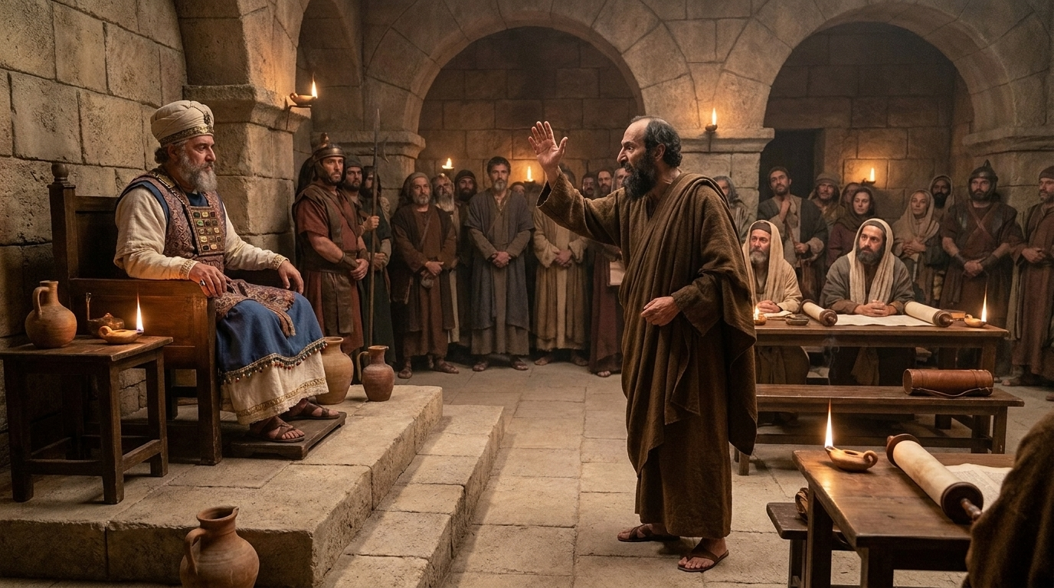
Acts 23:3-5

Slide 72
The Objector Echoes Job (vv. 19-20a)

Slide 73
The Objector Echoes Job (vv. 19-20a)
The Potter’s Rights (vv. 20b-21)

Slide 74
Rom. 9:20b
Rom. 9:20b
Will what is molded say to its molder, “Why have you made me like this?”
μὴ ἐρεῖ τὸ πλάσμα τῷ πλάσαντι· τί με ἐποίησας οὕτως;

Slide 75
Rom. 9:20b
Rom. 9:20b
Will what is molded say to its molder, “Why have you made me like this?”
μὴ ἐρεῖ τὸ πλάσμα τῷ πλάσαντι· τί με ἐποίησας οὕτως;

Slide 76
Rom. 9:20b
Rom. 9:20b
Will what is molded say to its molder, “Why have you made me like this?”
μὴ ἐρεῖ τὸ πλάσμα τῷ πλάσαντι· τί με ἐποίησας οὕτως;
Isaiah 29:16
Will what is made say of its maker, “You didn’t make me wisely!”

Slide 77
Rom. 9:20b
Rom. 9:20b
Will what is molded say to its molder, “Why have you made me like this?”
μὴ ἐρεῖ τὸ πλάσμα τῷ πλάσαντι· τί με ἐποίησας οὕτως;
Isaiah 29:16
Will what is made say of its maker, “You didn’t make me wisely!”
Isaiah 29:16
μὴ ἐρεῖ τὸ πλάσμα τῷ πλάσαντι…Οὐ συνετῶς με ἐποίησας;

Slide 78
Isaiah 29:16
You turn things upside down!

Slide 79
Isaiah 29:16
You turn things upside down!
Paul is using a metaphor of OT prophets

Slide 80
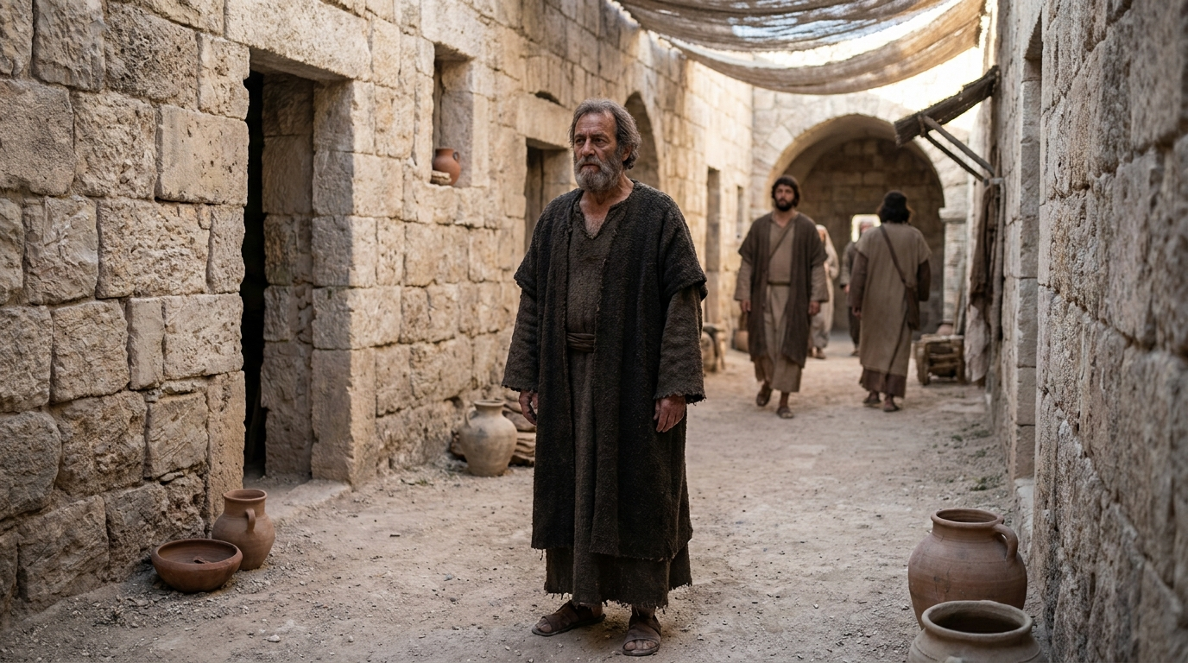
Jeremiah 18:1-6
The word that came to Jeremiah from the LORD: “Arise, and go down to the potter’s house, and there I will let you hear my words.” So I went down to the potter’s house, and there he was working at his wheel.
And the vessel he was making of clay was spoiled in the potter’s hand, and he reworked it into another vessel, as it seemed good to the potter to do.
Then the word of the LORD came to me: “O house of Israel, can I not do with you as this potter has done? declares the LORD. Behold, like the clay in the potter’s hand, so are you in my hand, O house of Israel.

Slide 81
Jeremiah 18:1-6
The word that came to Jeremiah from the LORD: “Arise, and go down to the potter’s house, and there I will let you hear my words.” So I went down to the potter’s house, and there he was working at his wheel.
And the vessel he was making of clay was spoiled in the potter’s hand, and he reworked it into another vessel, as it seemed good to the potter to do.
Then the word of the LORD came to me: “O house of Israel, can I not do with you as this potter has done? declares the LORD. Behold, like the clay in the potter’s hand, so are you in my hand, O house of Israel.

Slide 82
Jeremiah 18:1-6
The word that came to Jeremiah from the LORD: “Arise, and go down to the potter’s house, and there I will let you hear my words.” So I went down to the potter’s house, and there he was working at his wheel.
And the vessel he was making of clay was spoiled in the potter’s hand, and he reworked it into another vessel, as it seemed good to the potter to do.
Then the word of the LORD came to me: “O house of Israel, can I not do with you as this potter has done? declares the LORD. Behold, like the clay in the potter’s hand, so are you in my hand, O house of Israel.

Slide 83
Jeremiah 18:1-6
The word that came to Jeremiah from the LORD: “Arise, and go down to the potter’s house, and there I will let you hear my words.” So I went down to the potter’s house, and there he was working at his wheel.
And the vessel he was making of clay was spoiled in the potter’s hand, and he reworked it into another vessel, as it seemed good to the potter to do.
Then the word of the LORD came to me: “O house of Israel, can I not do with you as this potter has done? declares the LORD. Behold, like the clay in the potter’s hand, so are you in my hand, O house of Israel.

Slide 84
Jeremiah 18:1-6
The word that came to Jeremiah from the LORD: “Arise, and go down to the potter’s house, and there I will let you hear my words.” So I went down to the potter’s house, and there he was working at his wheel.
And the vessel he was making of clay was spoiled in the potter’s hand, and he reworked it into another vessel, as it seemed good to the potter to do.
Then the word of the LORD came to me: “O house of Israel, can I not do with you as this potter has done? declares the LORD. Behold, like the clay in the potter’s hand, so are you in my hand, O house of Israel.

Slide 85
Jeremiah 18:1-6
The word that came to Jeremiah from the LORD: “Arise, and go down to the potter’s house, and there I will let you hear my words.” So I went down to the potter’s house, and there he was working at his wheel.
And the vessel he was making of clay was spoiled in the potter’s hand, and he reworked it into another vessel, as it seemed good to the potter to do.
Then the word of the LORD came to me: “O house of Israel, can I not do with you as this potter has done? declares the LORD. Behold, like the clay in the potter’s hand, so are you in my hand, O house of Israel.

Slide 86
Jeremiah 18:1-6
The word that came to Jeremiah from the LORD: “Arise, and go down to the potter’s house, and there I will let you hear my words.” So I went down to the potter’s house, and there he was working at his wheel.
And the vessel he was making of clay was spoiled in the potter’s hand, and he reworked it into another vessel, as it seemed good to the potter to do.
Then the word of the LORD came to me: “O house of Israel, can I not do with you as this potter has done? declares the LORD. Behold, like the clay in the potter’s hand, so are you in my hand, O house of Israel.

Slide 87
Jeremiah 18:1-6
The word that came to Jeremiah from the LORD: “Arise, and go down to the potter’s house, and there I will let you hear my words.” So I went down to the potter’s house, and there he was working at his wheel.
And the vessel he was making of clay was spoiled in the potter’s hand, and he reworked it into another vessel, as it seemed good to the potter to do.
Then the word of the LORD came to me: “O house of Israel, can I not do with you as this potter has done? declares the LORD. Behold, like the clay in the potter’s hand, so are you in my hand, O house of Israel.

Slide 88
Rom. 9:20b
Rom. 9:20b
Will what is molded say to its molder, “Why have you made me like this?”
μὴ ἐρεῖ τὸ πλάσμα τῷ πλάσαντι· τί με ἐποίησας οὕτως;

Slide 89
Rom. 9:21
Rom. 9:21
Has the potter no right over the clay, to make out of the same lump one vessel for honorable use and another for dishonorable use?
ἢ οὐκ ἔχει ἐξουσίαν ὁ κεραμεὺς τοῦ πηλοῦ ἐκ τοῦ αὐτοῦ φυράματος ποιῆσαι ὃ μὲν εἰς τιμὴν σκεῦος ὃ δὲ εἰς ἀτιμίαν;

Slide 90
Rom. 9:21
Rom. 9:21
Has the potter no right over the clay, to make out of the same lump one vessel for honorable use and another for dishonorable use?
ἢ οὐκ ἔχει ἐξουσίαν ὁ κεραμεὺς τοῦ πηλοῦ ἐκ τοῦ αὐτοῦ φυράματος ποιῆσαι ὃ μὲν εἰς τιμὴν σκεῦος ὃ δὲ εἰς ἀτιμίαν;

Slide 91
Rom. 9:21
Rom. 9:21
Has the potter no right over the clay, to make out of the same lump one vessel for honorable use and another for dishonorable use?
ἢ οὐκ ἔχει ἐξουσίαν ὁ κεραμεὺς τοῦ πηλοῦ ἐκ τοῦ αὐτοῦ φυράματος ποιῆσαι ὃ μὲν εἰς τιμὴν σκεῦος ὃ δὲ εἰς ἀτιμίαν;

Slide 92
Rom. 9:21
Rom. 9:21
Has the potter no right over the clay, to make out of the same lump one vessel for honorable use and another for dishonorable use?
ἢ οὐκ ἔχει ἐξουσίαν ὁ κεραμεὺς τοῦ πηλοῦ ἐκ τοῦ αὐτοῦ φυράματος ποιῆσαι ὃ μὲν εἰς τιμὴν σκεῦος ὃ δὲ εἰς ἀτιμίαν;

Slide 93
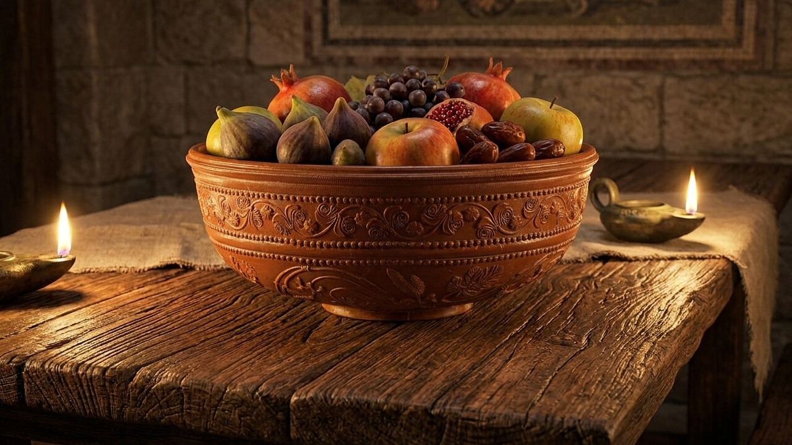
τιμή
valuable, esteemed

Slide 94
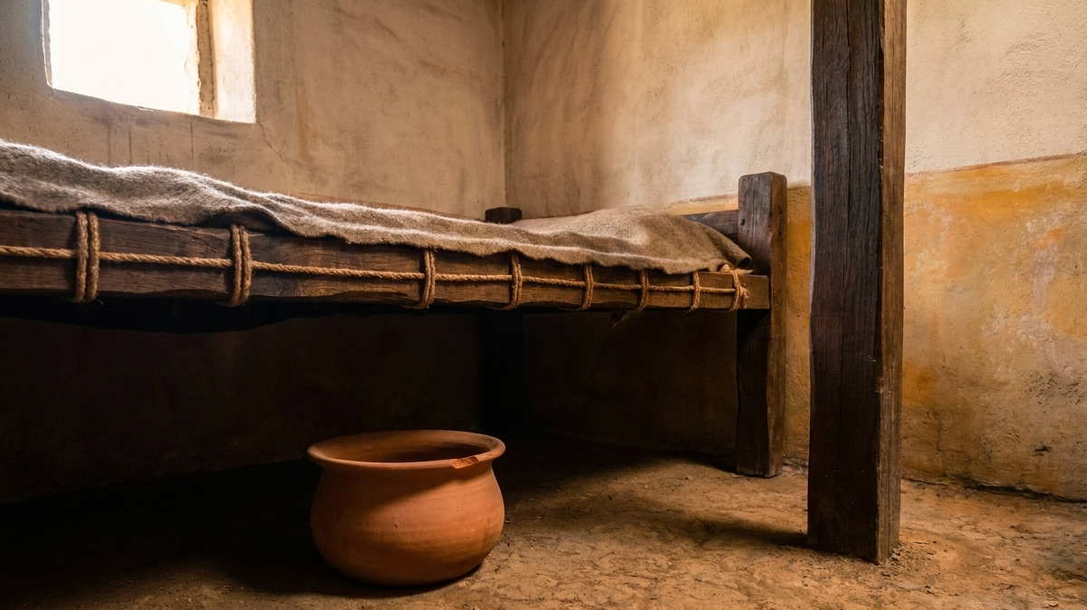
ἀ+τιμή
not valuable, not esteemed

Slide 95
“Why have you made me thus?

Slide 96
“Why have you made me thus?
What is the purpose of this vessel?

Slide 97
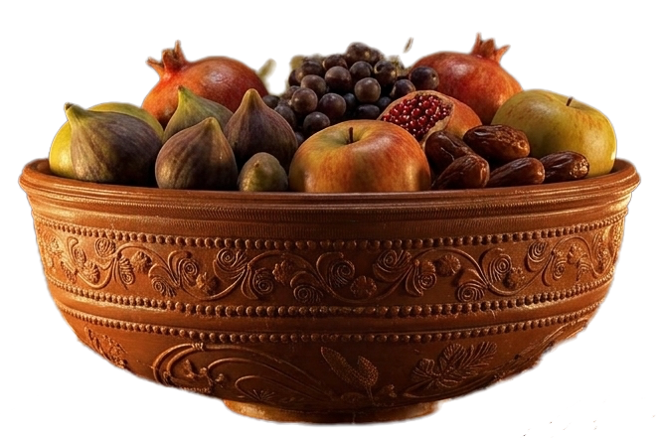
τιμή
valuable, esteemed
“Why have you made me thus?
What is the purpose of this vessel?

Slide 98

τιμή
valuable, esteemed
“Why have you made me thus?
What is the purpose of this vessel?
ἀ+τιμή
not valuable, not esteemed

Slide 99
The Objector Echoes Job (vv. 19-20a)
The Potter’s Rights (vv. 20b-21)

Slide 100
The Objector Echoes Job (vv. 19-20a)
The Potter’s Rights (vv. 20b-21)
Two vessels and an Open Door (vv. 22-24)

Slide 101
Rom. 9:22
Rom. 9:22
What if God, desiring to show his wrath and to make known his power, has endured with much patience vessels of wrath prepared for destruction,
εἰ δὲ θέλων ὁ θεὸς ἐνδείξασθαι τὴν ὀργὴν καὶ γνωρίσαι τὸ δυνατὸν αὐτοῦ ἤνεγκεν ἐν πολλῇ μακροθυμίᾳ σκεύη ὀργῆς κατηρτισμένα εἰς ἀπώλειαν,

Slide 102
Rom. 9:23
Rom. 9:23
in order to make known the riches of his glory for vessels of mercy, which he has prepared beforehand for glory—
καὶ ἵνα γνωρίσῃ τὸν πλοῦτον τῆς δόξης αὐτοῦ ἐπὶ σκεύη ἐλέους ἃ προητοίμασεν εἰς δόξαν;

Slide 103
Rom. 9:24
Rom. 9:24
even us whom he has called, not from the Jews only but also from the Gentiles?
Οὓς καὶ ἐκάλεσεν ἡμᾶς οὐ μόνον ἐξ Ἰουδαίων ἀλλὰ καὶ ἐξ ἐθνῶν,

Slide 104
This text teaches that God is free: free in mercy, free in hardening, and answerable to no one.

Slide 105
This text teaches that God is free: free in mercy, free in hardening, and answerable to no one.
But…..

Slide 107
Ex. 8:15
But when Pharaoh saw that there was a respite, he hardened his heart and would not listen to them, as the LORD had said.

Slide 108
Ex. 8:15
But when Pharaoh saw that there was a respite, he hardened his heart and would not listen to them, as the LORD had said.
What if Pharaoh let them go earlier?

Slide 109
This text teaches that God is free: free in mercy, free in hardening, and answerable to no one.
But…..

Slide 110


Rom. 9:22
Rom. 9:22
What if God, desiring to show his wrath and to make known his power, has endured with much patience vessels of wrath prepared for destruction,
εἰ δὲ θέλων ὁ θεὸς ἐνδείξασθαι τὴν ὀργὴν καὶ γνωρίσαι τὸ δυνατὸν αὐτοῦ ἤνεγκεν ἐν πολλῇ μακροθυμίᾳ σκεύη ὀργῆς κατηρτισμένα εἰς ἀπώλειαν,

Slide 111
Rom. 9:22
Rom. 9:22
What if God, desiring to show his wrath and to make known his power, has endured with much patience vessels of wrath prepared for destruction,
εἰ δὲ θέλων ὁ θεὸς ἐνδείξασθαι τὴν ὀργὴν καὶ γνωρίσαι τὸ δυνατὸν αὐτοῦ ἤνεγκεν ἐν πολλῇ μακροθυμίᾳ σκεύη ὀργῆς κατηρτισμένα εἰς ἀπώλειαν,

Slide 112
Rom. 9:22
Rom. 9:22
What if God, desiring to show his wrath and to make known his power, has endured with much patience vessels of wrath prepared for destruction,
εἰ δὲ θέλων ὁ θεὸς ἐνδείξασθαι τὴν ὀργὴν καὶ γνωρίσαι τὸ δυνατὸν αὐτοῦ ἤνεγκεν ἐν πολλῇ μακροθυμίᾳ σκεύη ὀργῆς κατηρτισμένα εἰς ἀπώλειαν,

Slide 113
Rom. 9:23
Rom. 9:23
in order to make known the riches of his glory for vessels of mercy, which he has prepared beforehand for glory—
καὶ ἵνα γνωρίσῃ τὸν πλοῦτον τῆς δόξης αὐτοῦ ἐπὶ σκεύη ἐλέους ἃ προητοίμασεν εἰς δόξαν;

Slide 114
Rom. 9:23
Rom. 9:23
in order to make known the riches of his glory for vessels of mercy, which he has prepared beforehand for glory—
καὶ ἵνα γνωρίσῃ τὸν πλοῦτον τῆς δόξης αὐτοῦ ἐπὶ σκεύη ἐλέους ἃ προητοίμασεν εἰς δόξαν;

Slide 115
Rom. 9:24
Rom. 9:24
even us whom he has called, not from the Jews only but also from the Gentiles?
Οὓς καὶ ἐκάλεσεν ἡμᾶς οὐ μόνον ἐξ Ἰουδαίων ἀλλὰ καὶ ἐξ ἐθνῶν,

Slide 116


Slide 117
Rom. 9:25
Rom. 9:25
As indeed he says in Hosea, “Those who were not my people I will call ‘my people,’
and her who was not beloved I will call ‘beloved.’”
ὡς καὶ ἐν τῷ Ὡσηὲ λέγει· καλέσω τὸν οὐ λαόν μου λαόν μου καὶ τὴν οὐκ ἠγαπημένην ἠγαπημένην·

Slide 118

Points for Home

Slide 119
Question like Job, not a lawyer!
Points for Home

Slide 120
Question like Job, not a lawyer!
Points for Home
“But who are you, O man, to answer back to God?”
(Rom. 9:20)

Slide 122
Points for Home

Slide 123
Speak as Paul;
and hold your breath!
Points for Home

Slide 124
Speak as Paul;
and hold your breath!
Points for Home
“He prepared vessels of mercy”
(Rom. 9:23)
“Vessels of wrath were prepared” (9:22)

Slide 125
Points for Home

Slide 126
You who belong to Christ are not a spectator!
Points for Home

Slide 127
You who belong to Christ are not a spectator!
Points for Home
“even us whom he has called”
(Rom. 9:24)

Slide 128

Lunch topic:

Slide 129
How can you see God working his glory amidst hardship and sin?
Lunch topic:

Slide 130
Romans

